Slide 1
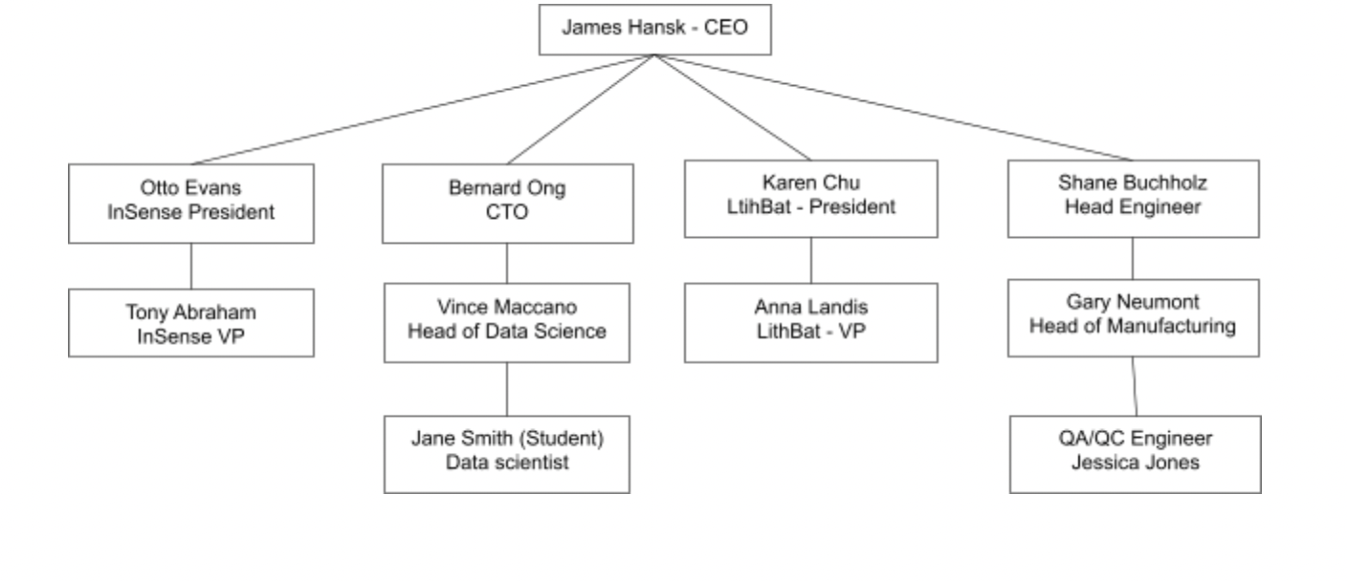
Problem Statement Worksheet (Hypothesis Formation)
The 15% failure rate for InSense manufacturing in March is due to operations at a given factory, or faulty parts from one or more suppliers
H
1
Context
4
Constraints within solution space
Facts
InSense failure rate during testing was 1-2%
InSense failure rate in March was 15%
We can tolerate a 5% failure rate
Current Assumptions
At a 15% value rate, orders will take longer and be more costly to Nordic Sensing
We are assuming that the failure rate in March will continue — that it’s the new “normal” until we take measures to improve.
Assuming there is no shortage of parts - which would block s from being able to fill our current and future orders
The currently identified potential culprits are:
Faulty execution at a given factory
Faulty parts
Faulty suppliers
We have orders to fill now
Meeting is tomorrow and VP wants to review tomorrow morning
Data received is incomplete - a complete set could provide better insights
5
Stakeholders to provide key insight
We have Stakeholders, but no roles - we can guess, but it would be better to define how each person can help or oversee our efforts
2
Criteria for success
6
Key data sources
Identify whether the 15% failure rate in March was due to operations at a given factory, faulty InSense parts overall, or InSense parts from a given supplier
Cert data: we have 20 rows in excel format — is it from March? Can we get the full set?
Assume that data is tabular and should have all the fields we need : manufacturer, supplier, factory, data and failures
3
Scope of solution space
We can look at the existing data if we can get complete data
Otherwise we have already done chi-squared on the 20 rows(?) and found nothing - we can re-check it?
A complete picture could take longer than 1 day, should we expect some longer milestones, or is it “all or nothing” for tomorrow?
H
D
E
I
P
Notes:
Hypothesis: Create a Hypothesis with an emphasis on SMART principles. (S – Specific, M – Measurable, A – Achievable, R – Realistic, T – Timebound). If you cannot do this, you do not have a good grasp on the business problem.
Context: With context, we have clearly identified the problem at hand and have elucidated on how our initiative may solve this problem, alongside the commercial implications this will have on the business.
Criteria for Success: Clearly defining the criteria for success ensures that the scope of your work is clearly defined and understood. Otherwise, if this isn’t defined – your work will never end which will result in mismatched expectations.
Scope of Solution Space: Scoping out the solution space ensures that the business initiative is SPECIFIC for a certain segment or area. This prevents solutions that have been developed being scaled and applied for all other business units that the solution may not be responsible or scalable for.
Constraints within Solution Space: Looking forward, what are the foreseeable problems we are likely to encounter? Could this be stakeholder resistance? Could this be we don’t have access to the right data?
Stakeholders to provide key insight: Who are the people I need to speak to, to get the answers I need for my data analysis?
What key data sources are required?
Based off my discussions with the key stakeholders – can we clearly list out all the data sources we need so we can make a highly targeted request as opposed to a scatter-gun approach where we ask for a bit of everything?

